Slide 1
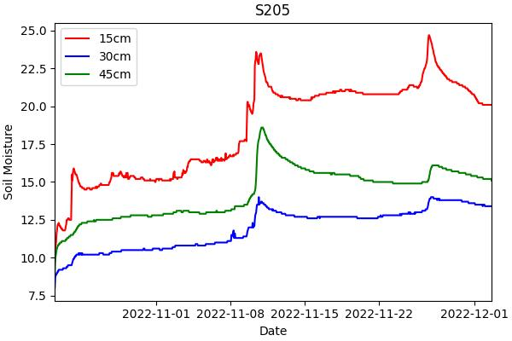
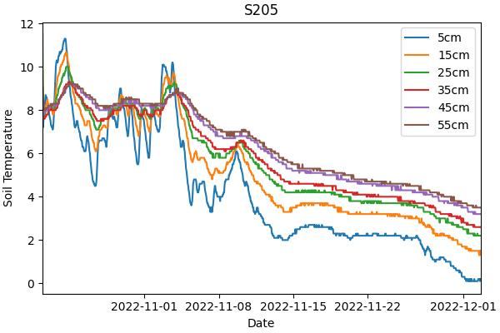
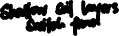
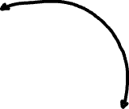
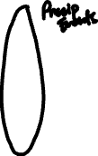
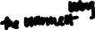

Slide 2
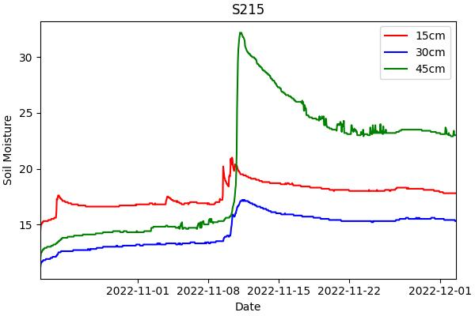
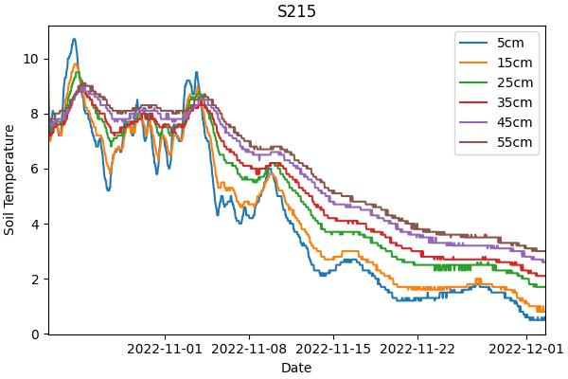
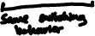

Slide 3
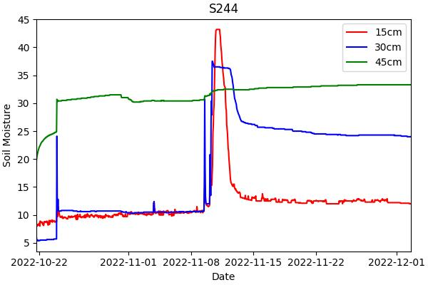
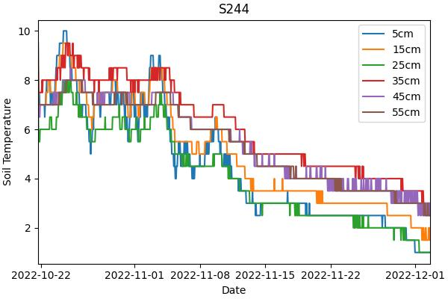
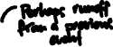
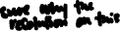

Slide 4
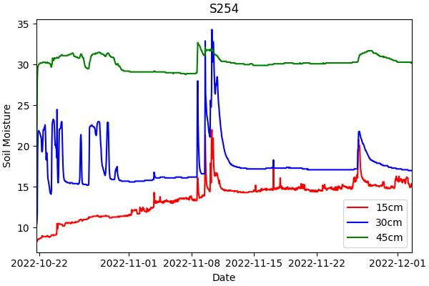
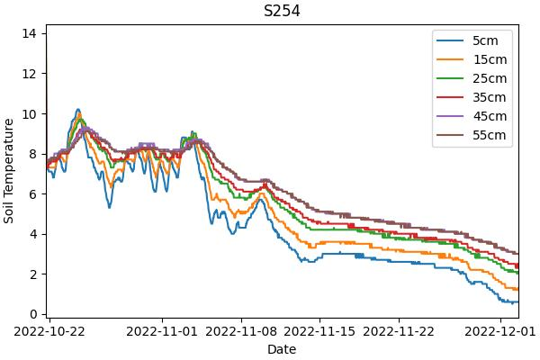
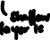
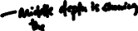
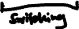

Slide 5
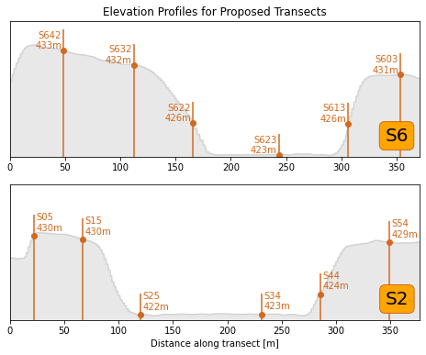

Slide 6


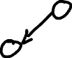
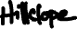

Slide 7
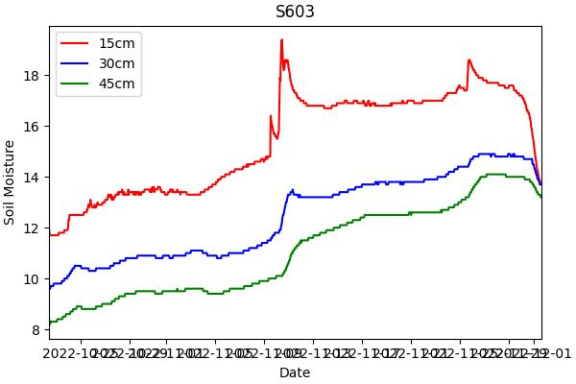
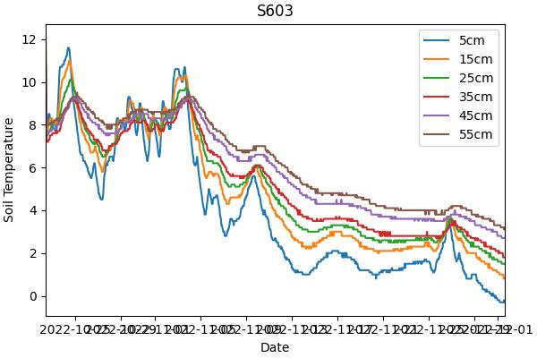
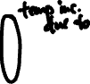
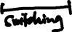

Slide 8
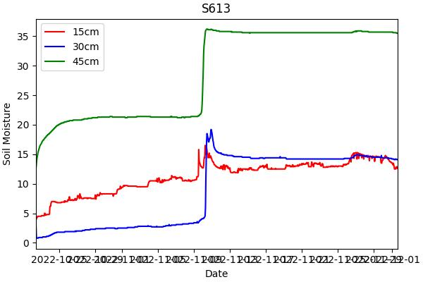
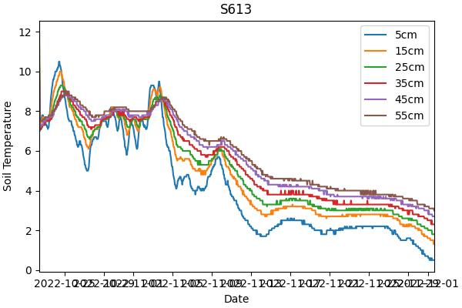
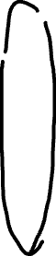
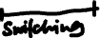

Slide 9
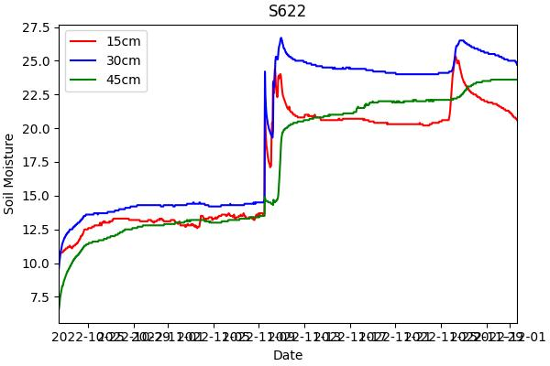
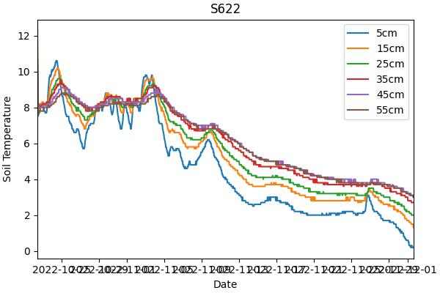

Slide 10
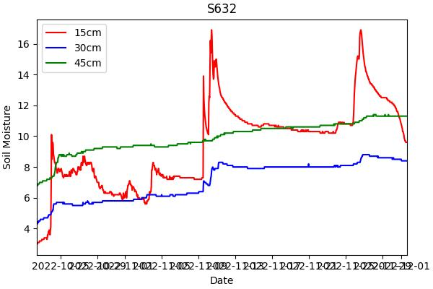
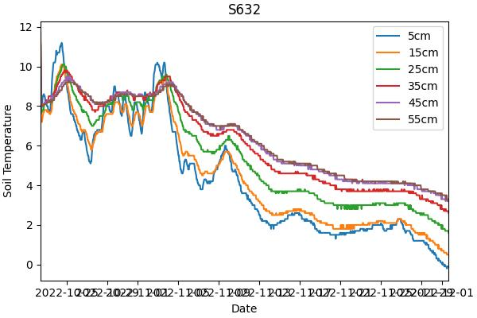
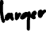
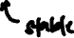
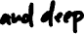
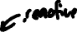

Slide 11

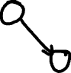

Slide 12


Slide 13
Updated Soil Data

Slide 14
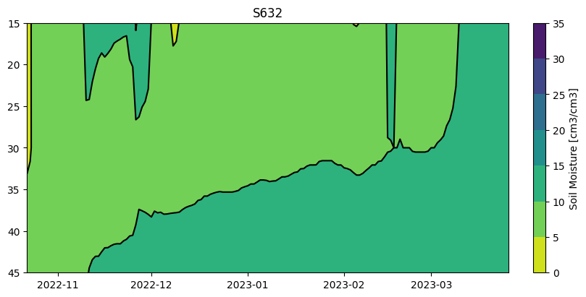
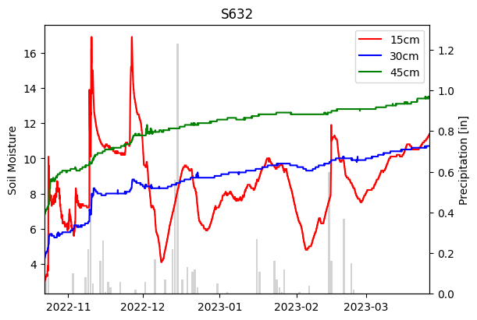
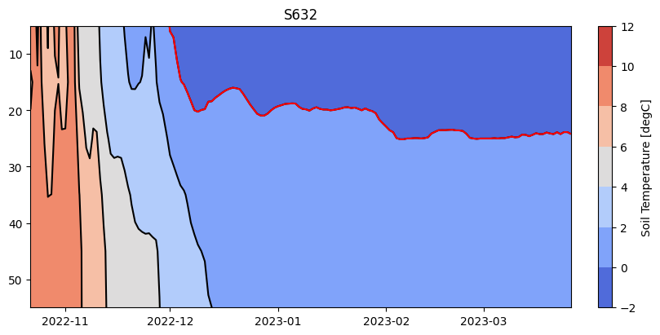
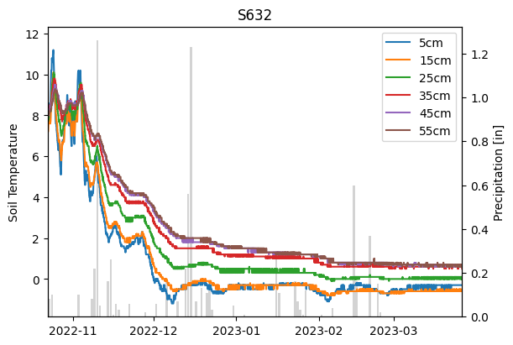

Slide 15
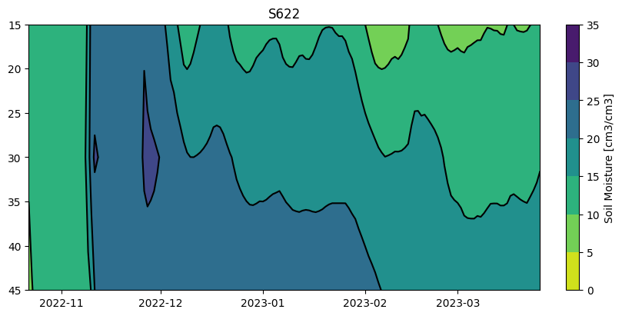
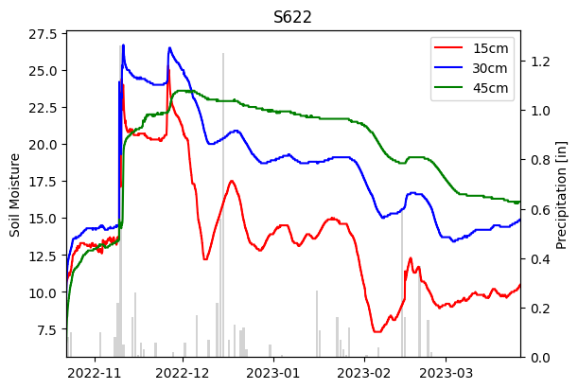
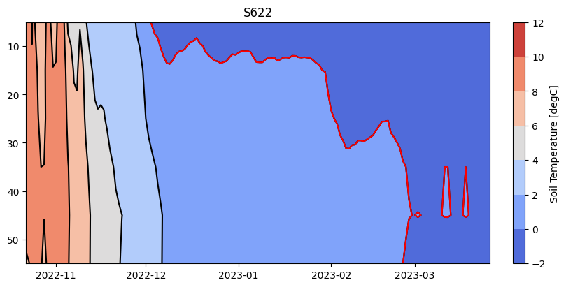
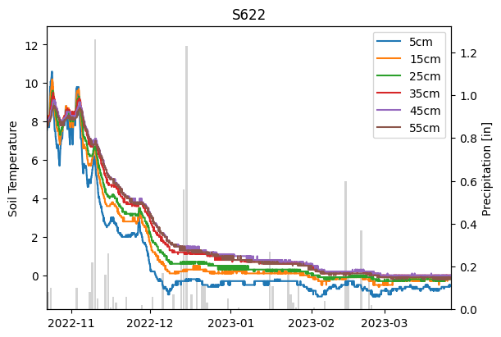

Slide 16
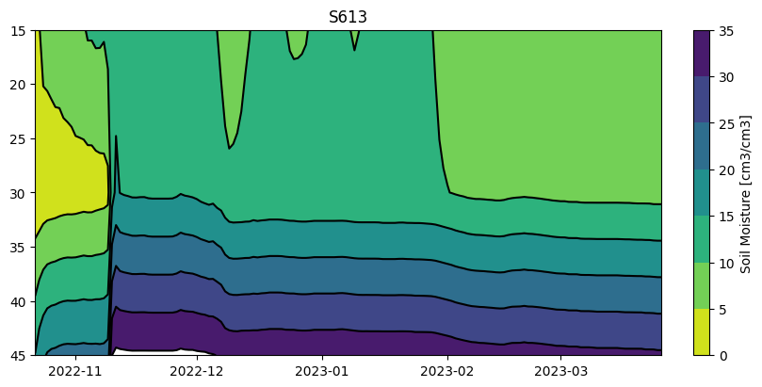
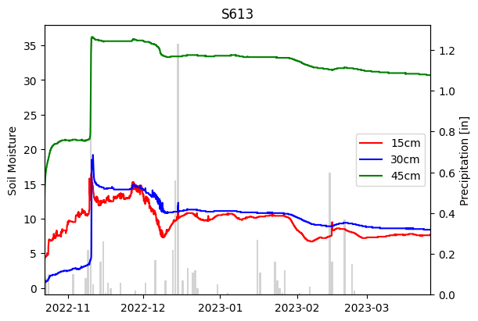
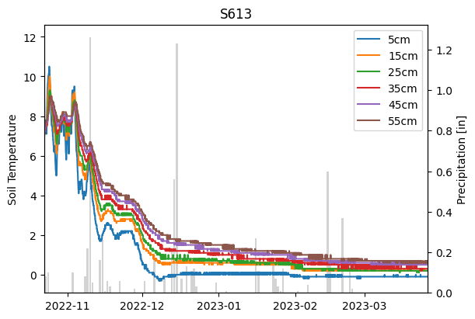
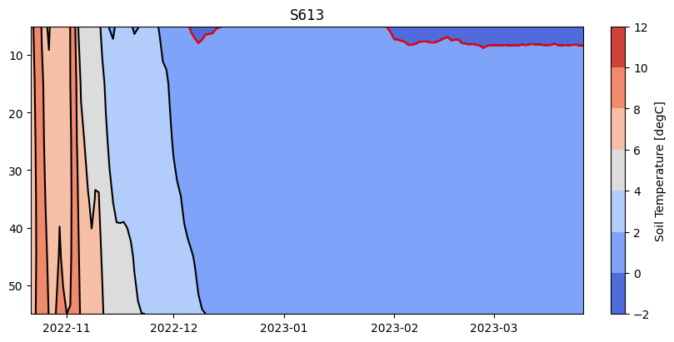

Slide 17





Slide 18





Slide 19





Slide 20





Slide 21





Slide 26
Summer 2022 LAI

Slide 27


Slide 28


4 Ring
Zenith angles 0 – 60
ANOVA in S6 showed no significance (p = 0.357).
ANOVA in S2 found significant difference with p = 0.0197.
Tukey test showed difference between Upland and Bog values for LAI ring 4 (p = 0.021).
ANOVA showed no significant difference between the watersheds (p = 0.313).
5 Ring
Zenith angles 0 – 75

Slide 29
Winter 2022-2023 LAI

Slide 30


Slide 31

4 Ring
Zenith angles 0 – 60
5 Ring
Zenith angles 0-75
ANOVA in S2 found significant difference with p = 0.000168.
Tukey test showed difference between Upland and Bog at the 0.01 significance level (p = 0.000).
And Upland and Lagg at the 0.1 significance level (p = 0.062)

Slide 32
2022-2023 Snow Depth Data

Slide 33








Slide 34


Slide 35


Slide 36



Slide 37


Slide 38
Winter 2022-2023 Snow/LAI Comparisons

Slide 39


Slide 40


Slide 41



Slide 42


Slide 44

“Base CLM” – no hillslope or CLM SPRUCE modifications
Best result from base CLM parameter estimation
-- Used Bayesian Optimization to estimate the values of 7 plant, soil, and hydrologic parameters
-- Plot shows several simulated years with different parameter combinations

Slide 45

HAND – height above nearest drainage
DTND – distance to nearest drainage
Estimates are purely based off the elevations derived from the S2 DEM using an algorithm NCAR developed for the hillslope model
(Up) Upland
Upland/Slope
Bog
Lagg
Not perfect…but a good start.

Slide 46



Slide 47


